Slide 1

Business Analysis of Retail and Shopping
PRESENTED BY Yimin Zhou, Xinyue Cao

Slide 2
DATA SET

Slide 3
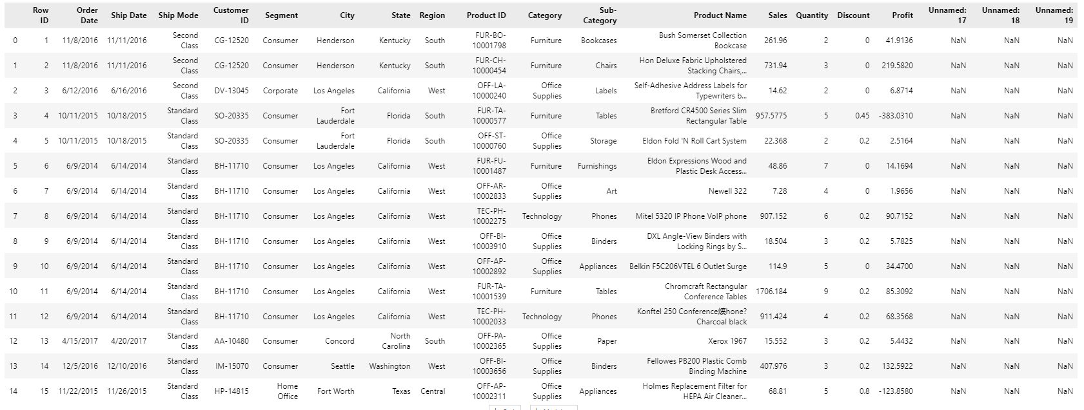
Data Set of The Store
ADD YOUR TEXT
点击此处添加标题
标题数字等都可以通过点击和重新输入进行更改，顶部“开始”面板中可以对字体、字号、颜色、行距等进行修改。建议正文8-14号字，1.3倍字间距。
标题数字等都可以通过点击和重新输入进行更改，顶部“开始”面板中可以对字体、字号、颜色、行距等进行修改。建议正文8-14号字，1.3倍字间距。
标题数字等都可以通过点击和重新输入进行更改，顶部“开始”面板中可以对字体、字号、颜色、行距等进行修改。建议正文8-14号字，1.3倍字间距。

Slide 4
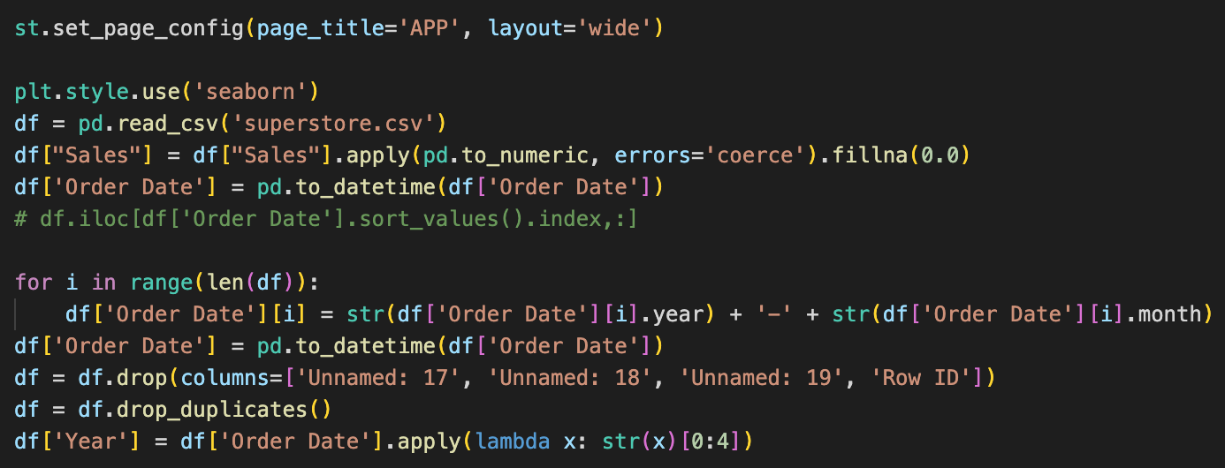
Data Set of The Store
Clean & organize the data
1. Remove some useless columns
2. Remove the duplicate rows.
3. The dates were processed to make it easier to be sorted.

Slide 5
Ship Mode Analysis

Slide 6
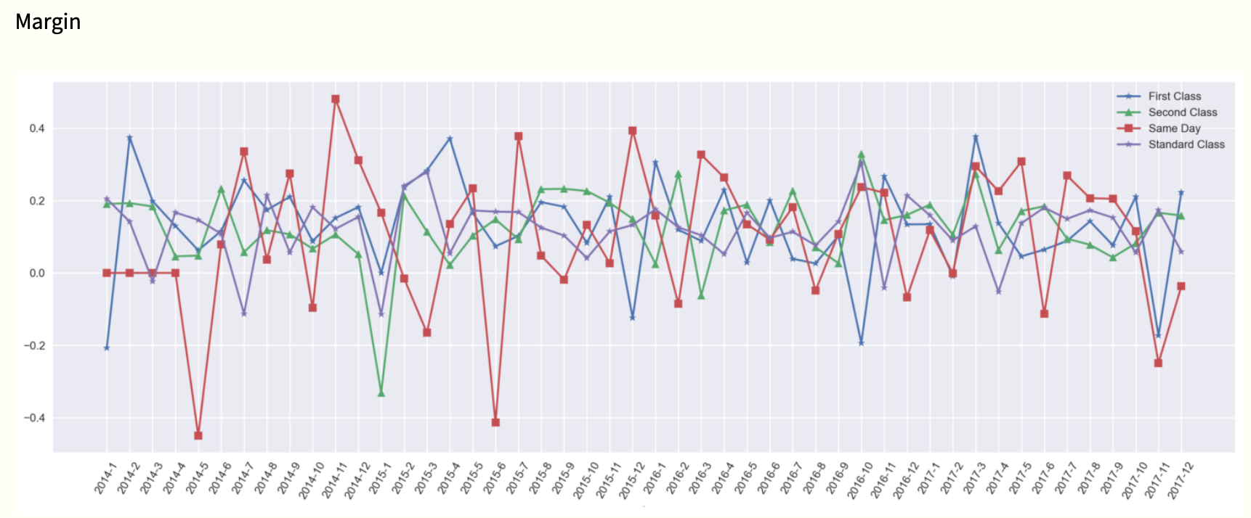
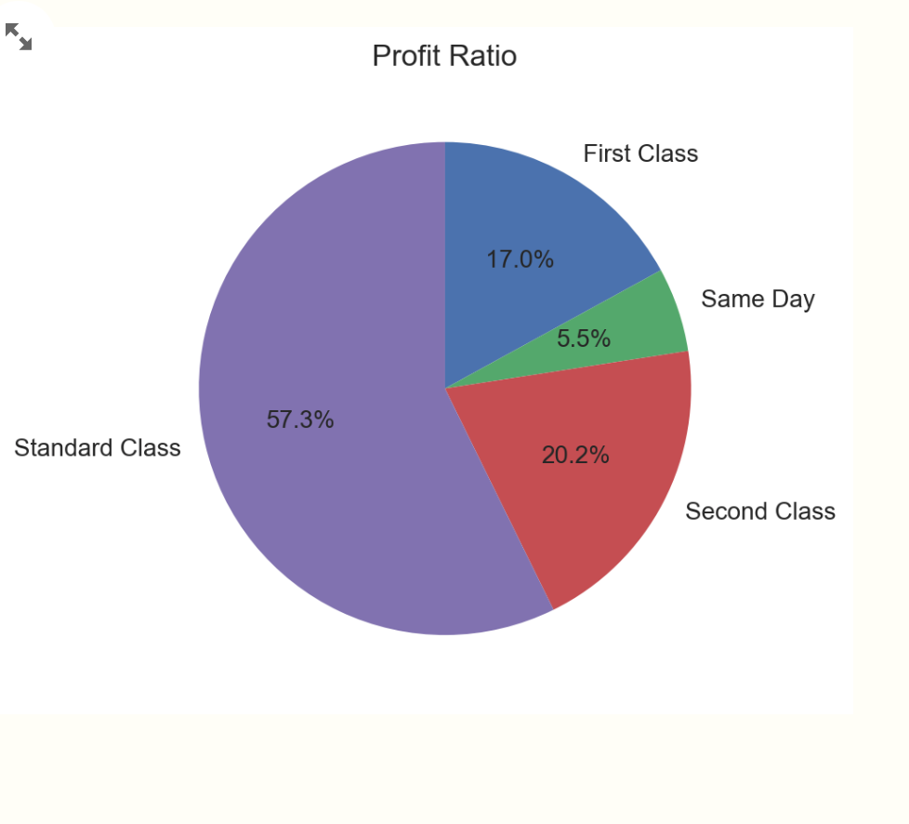
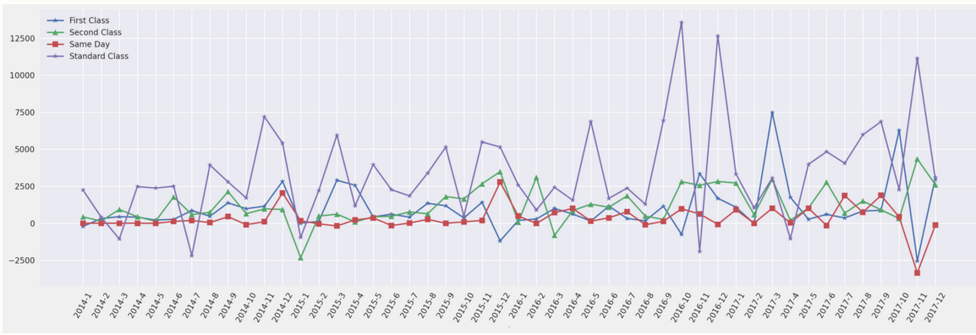
Which transportation mode had the highest profitability in the transportation mode analysis? Which transportation mode had the most efficient profit structure? Which transportation mode was the least stable? What were the periods of loss for the company that were worth noting and investigating?
Standard Class;
First Class; Standard Class; 2015.1, 2016.11, 2017.11

Slide 7

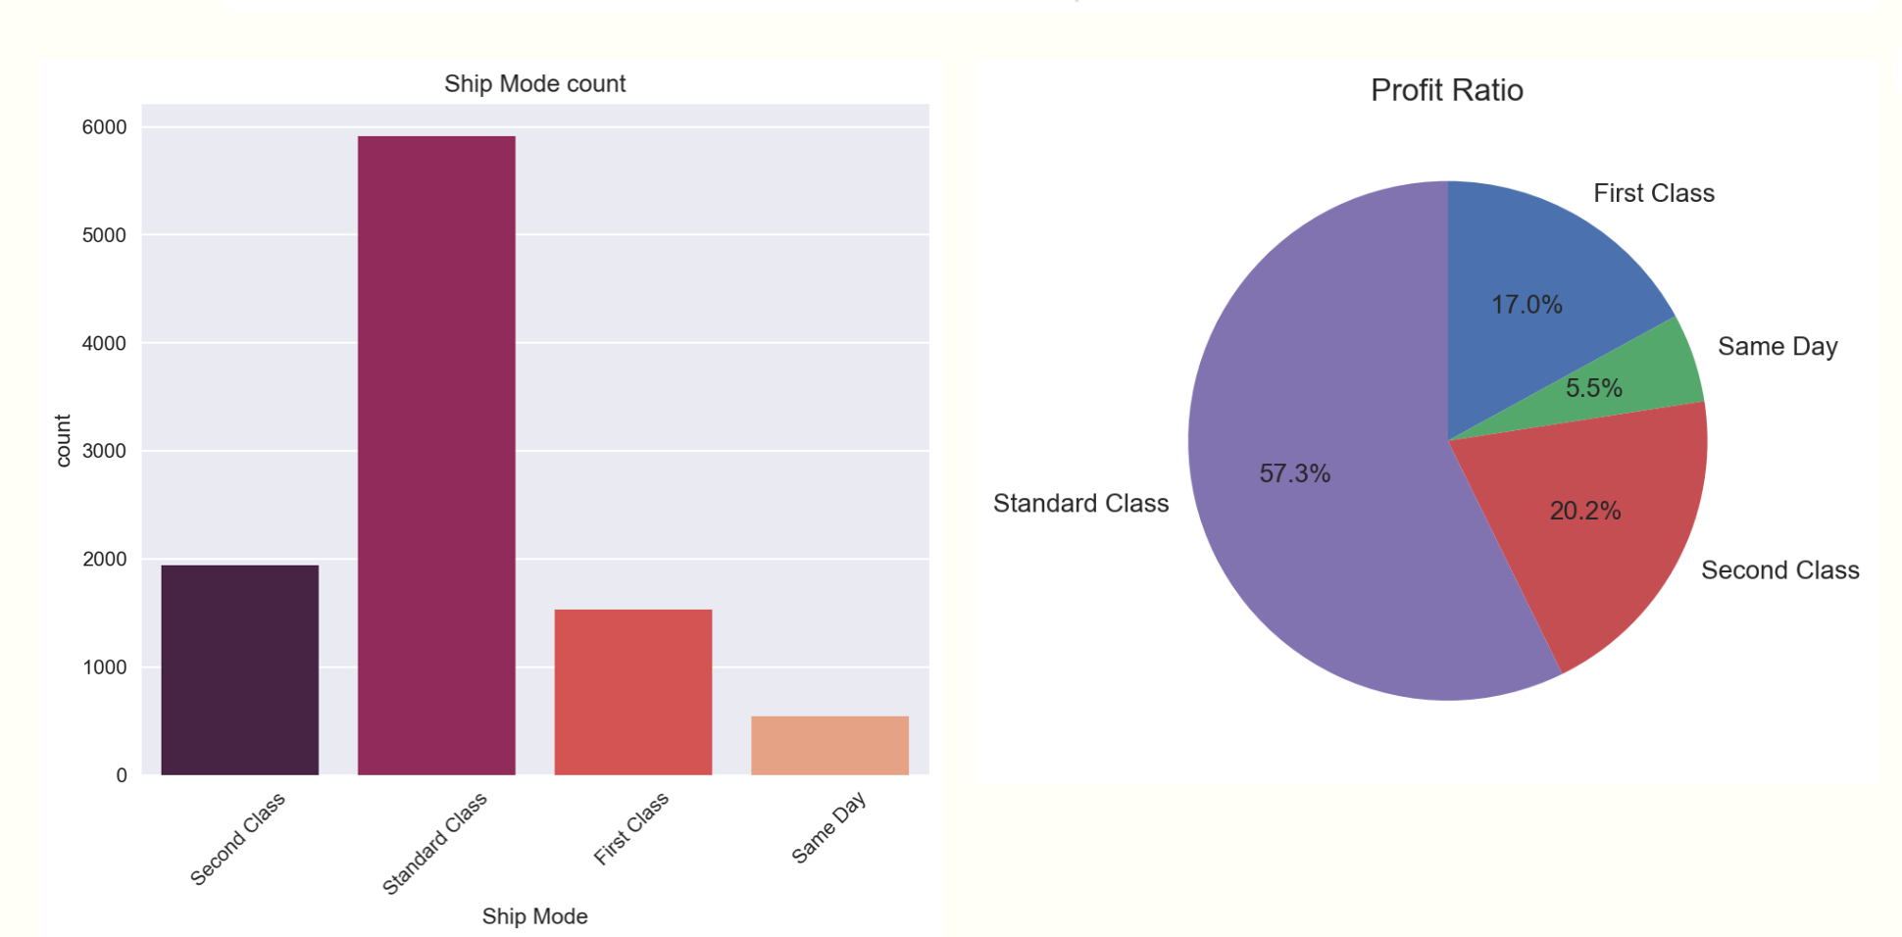
The relationship between the number of orders and the profit of the transport mode?
For someday, first class, second class, the number of orders and profit were almost linear with a uniform slope. But for standard class, the slope decreased.

Slide 8
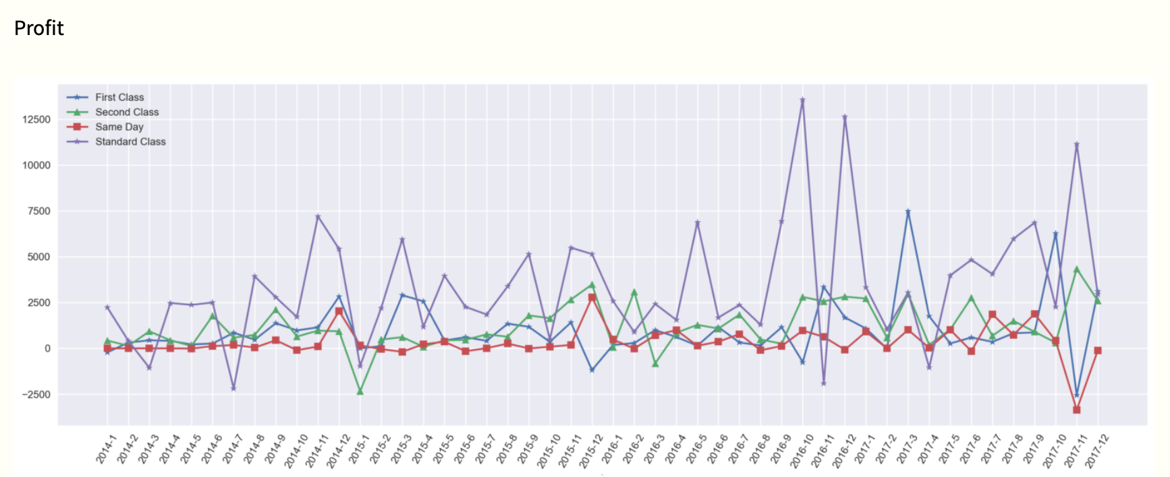
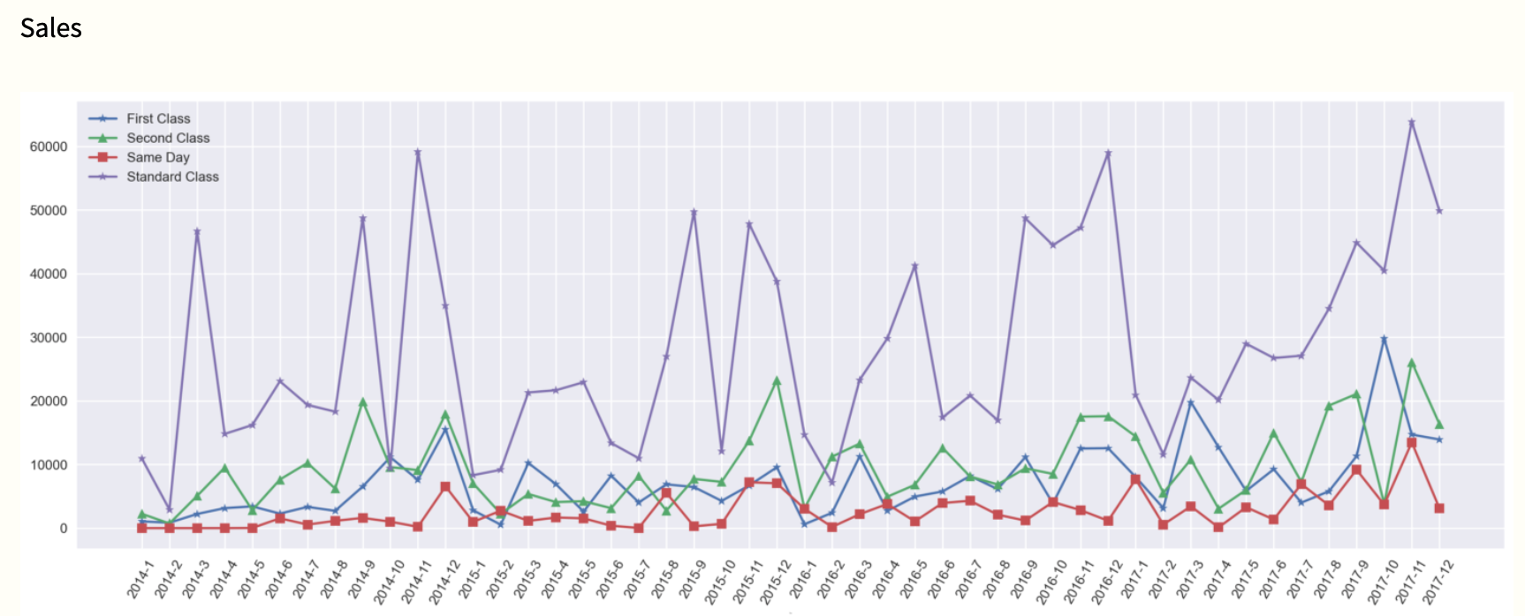
What improvements should the company make in its transportation modes?
First class: pay attention to the sales of technology products to make the corresponding synchronization adjustment.
Secondclass : the passage of time profit and margin always stable above 0, and this need to be maintained.
Sameday: margin fluctuated the most, profit accounts for the least, the contribution to profit was the least, the number of orders was also the least. The company should eliminate this business or optimize the cost structure.
Standard class: profit fluctuated strongly, margin is relatively stable compared with other models, it was sales that fluctuates strongly, and should strengthen the control of revenue.

Slide 9
Product Analysis

Slide 10
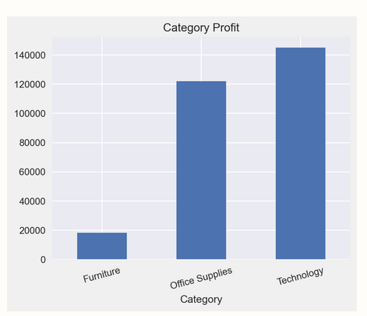
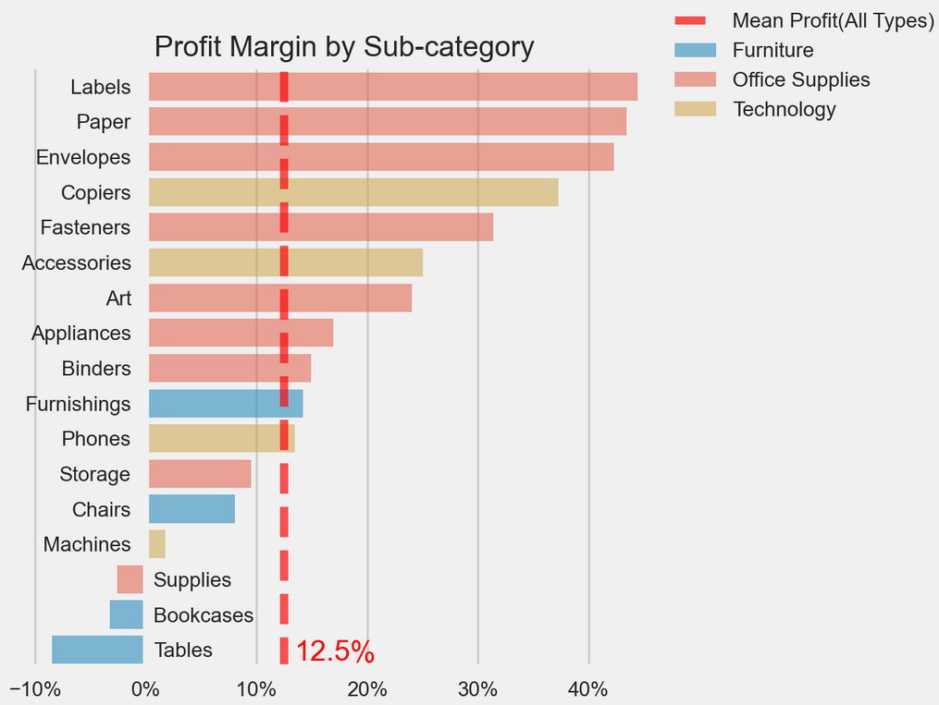
PART ONE 选题背景
Product Analysis Question
Which product had the highest profit ?
Technology
Which product had the most efficient profit structure ?
Office Supplies
标题数字等都可以通过点击和重新输入进行更改，顶部“开始”面板中可以对字体、字号、颜色、行距等进行修改。建议正文8-14号字，1.3倍字间距。

Slide 11
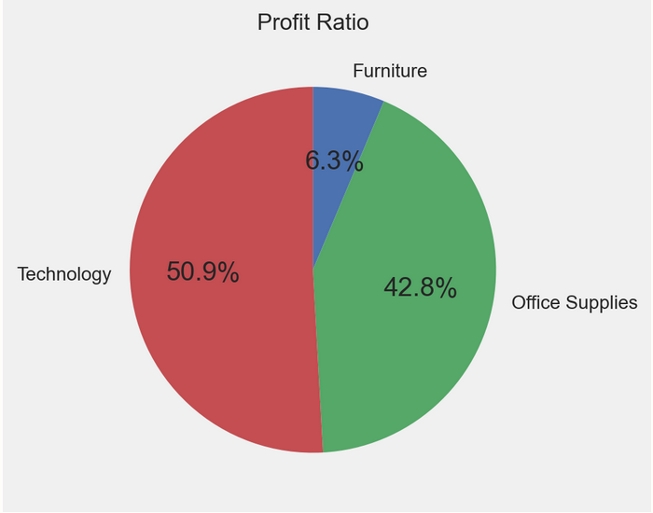
How did the types of the product of the company influence the profit & margin ?
Among the three major product, the profit was mainly contributed by Technology products and Office Supplies.

Slide 12
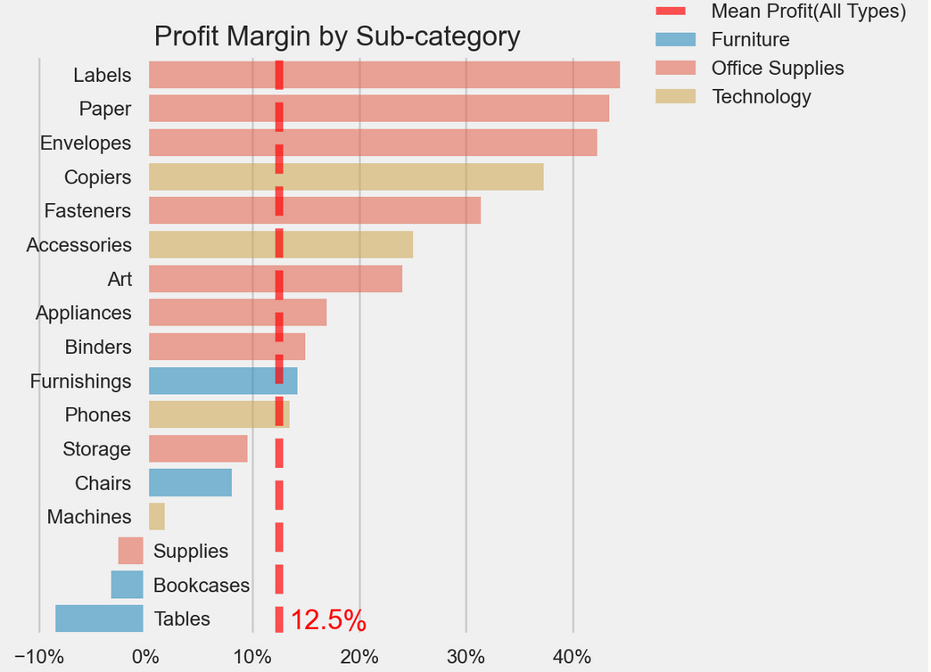
The company had a very high margin (more than double the company’s total margin) on a few of the sub-categories. Mainly within Office Supplies. Half of Technology’s subcategories also had a high margin. The chart also confirms that the profit margin on the sub-categories within Furniture were low. Two of the sub-categories from Furniture were even being sold at a loss. But technology was contributing most to the profit because of the outstanding performance in sales.

Slide 13
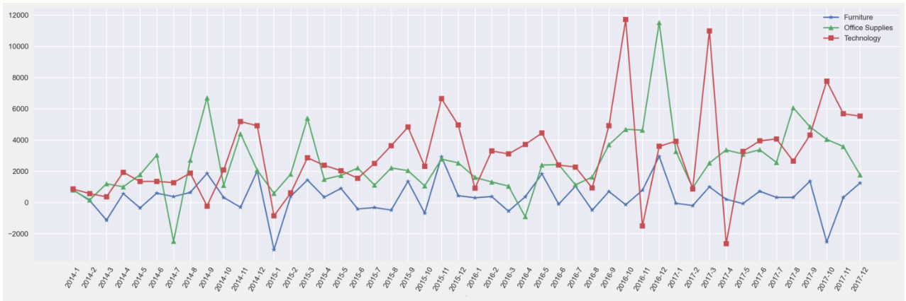
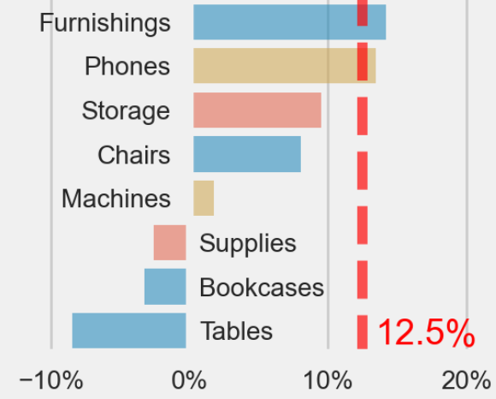
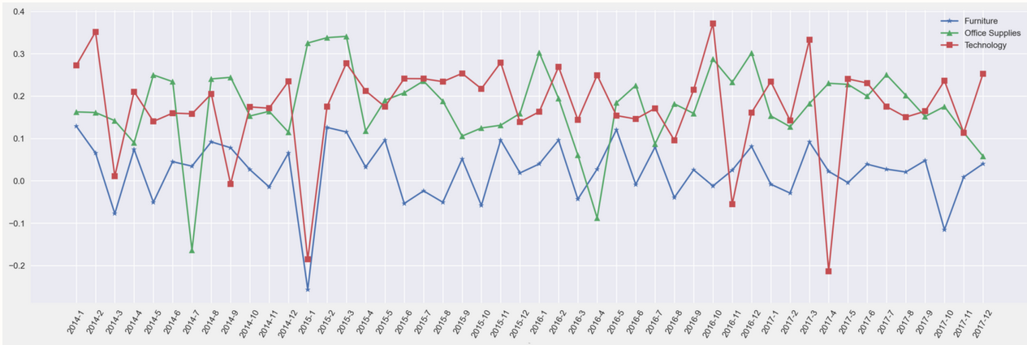
What improvements should be made in the company's business for several products ?
Even though for Furniture the overall sales were increasing month by month, nearly half of the months had a negative margin and the profit was fluctuating around 0 for a long time, the company should reduce the furniture business or carry out related cost control.

Slide 14
Segment Analysis

Slide 15
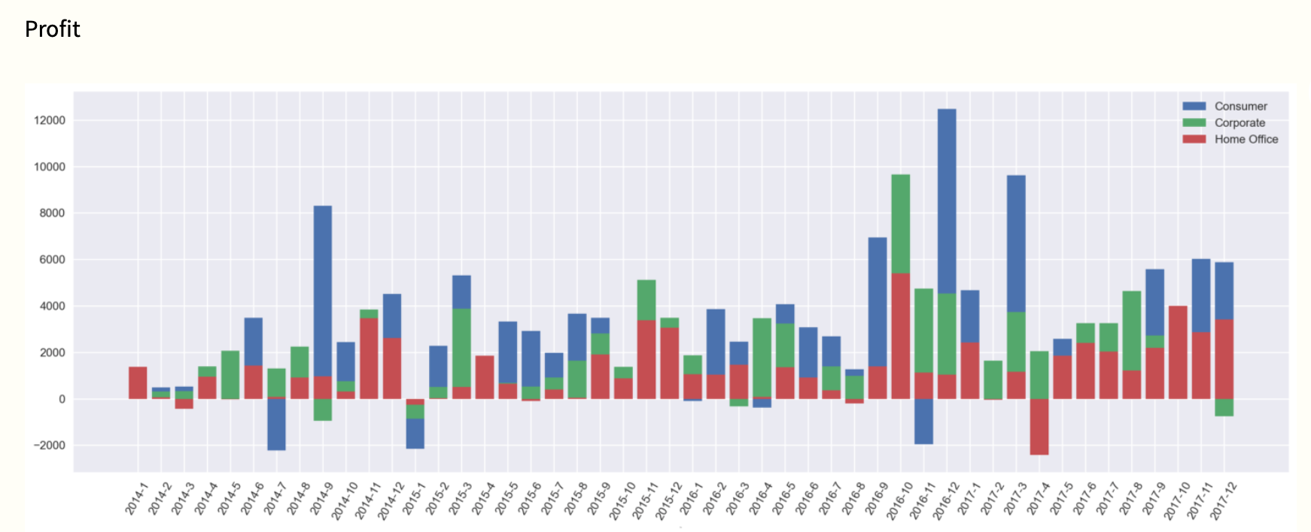
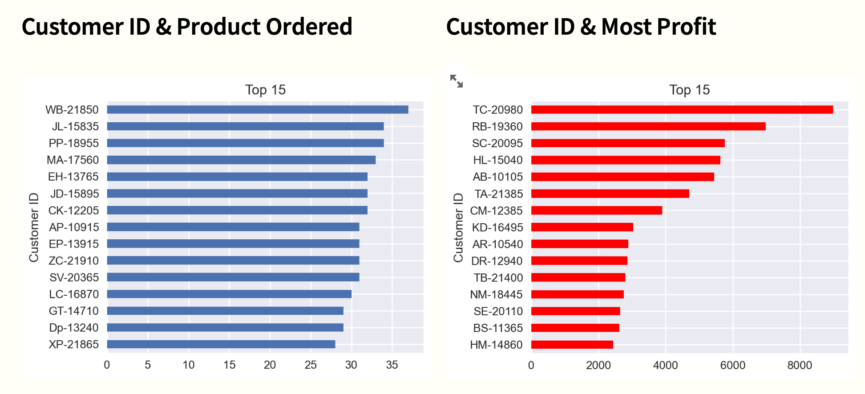
The highest profit source group?
consumer segment
Provide the highest profit buyer ID?
TC-20980
Most ordered buyer ID?
WB-21850

Slide 16
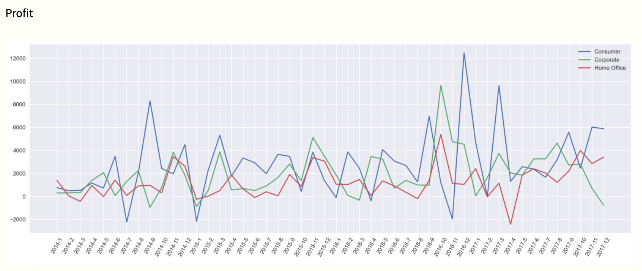
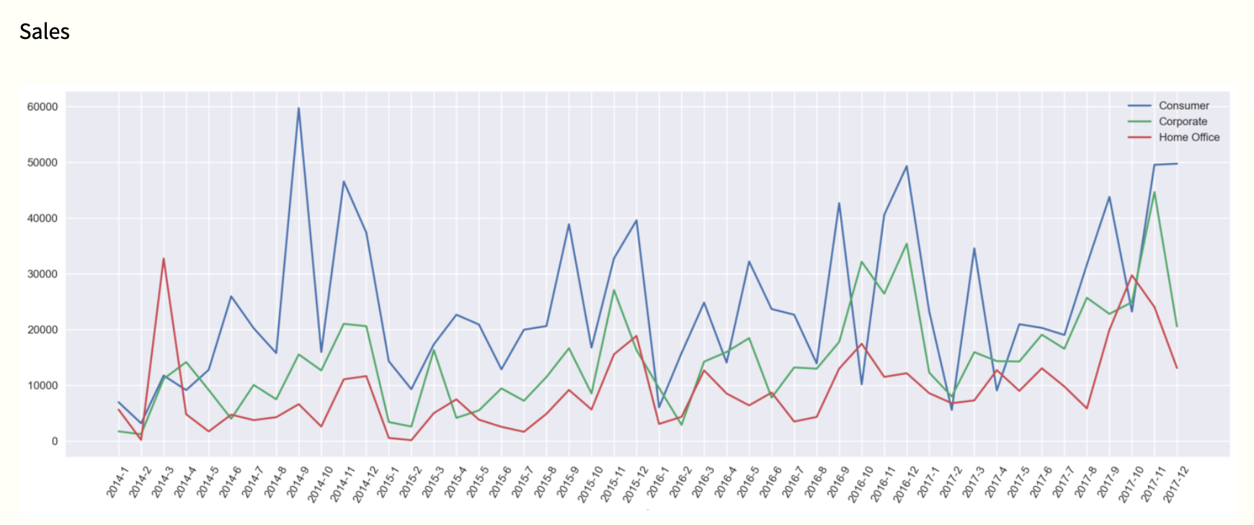
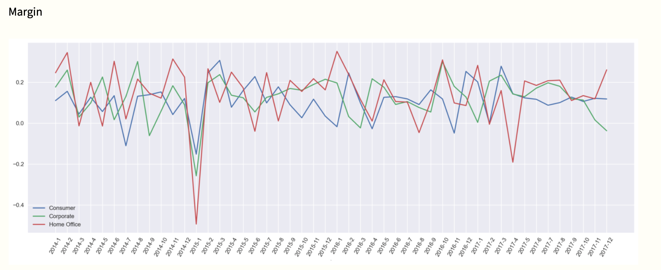
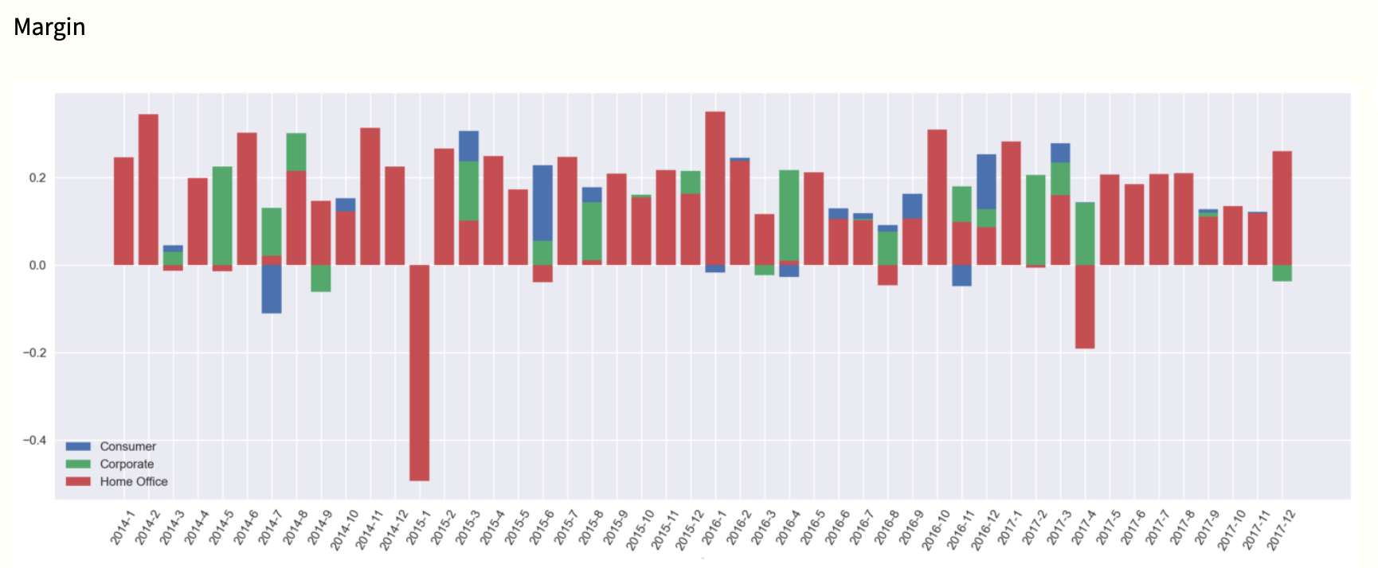
High profits and the volume of orders placed were not directly related to the two top15 and list of IDs do not overlap, which was as the same trend as technology products, because the number of technology products ordered was not high but the price is high. Therefore the buyer of technology was the most important ones.
The consumer segment had a bit lower profit margin comparing with Corporate and Home Office. This was most likely explained by the high volume of sales it’s doing in Furniture, which we saw before the lowest profit margin out of all the categories of products.

Slide 17
Region Analysis

Slide 18
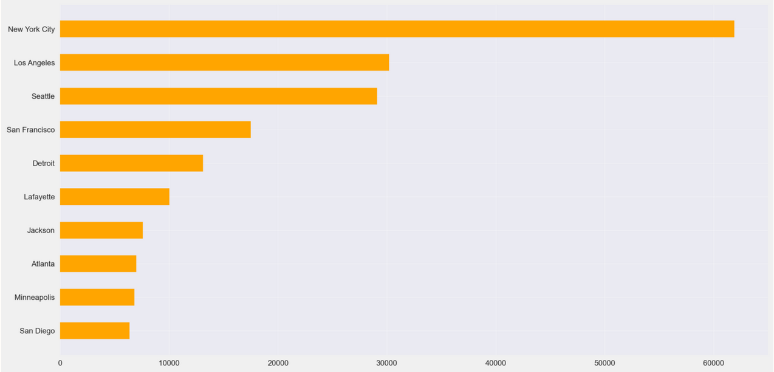
Region Analysis
Which city contribute the highest profit?
New York
New York City contributed the highest profit. Although margin was not in the top15 but with sales and technology products bought brought the highest profit.
HOW?

Slide 19
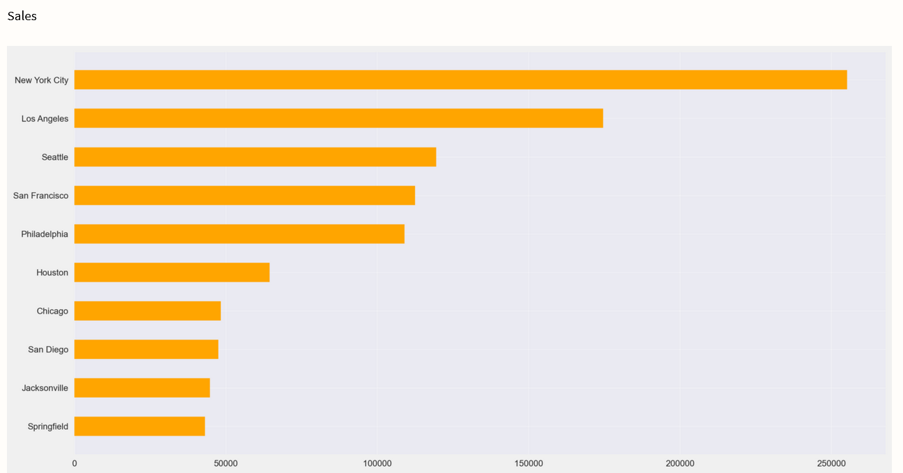

Slide 20

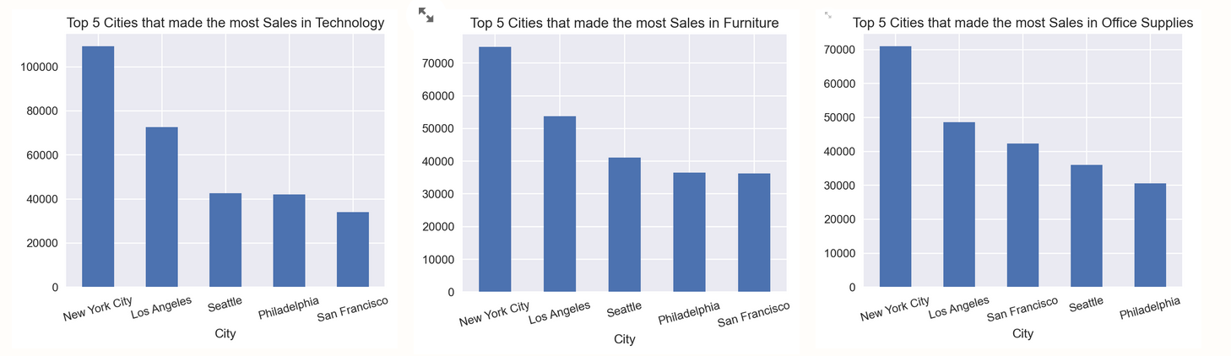
How did cities and their margin relate ?
The margin of large cities was not high, and margin was inversely proportional, small cities were the opposite but large cities had high sales, resulting in higher profit.
What should the company do ?
The company should focus its attention on these big cities. And optimize the cost structure and increase the margin in the big cities to further increase the profit.

Slide 21
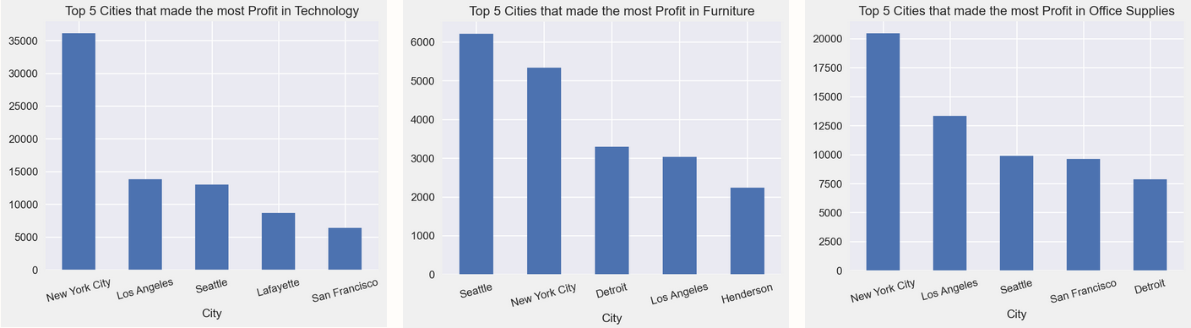
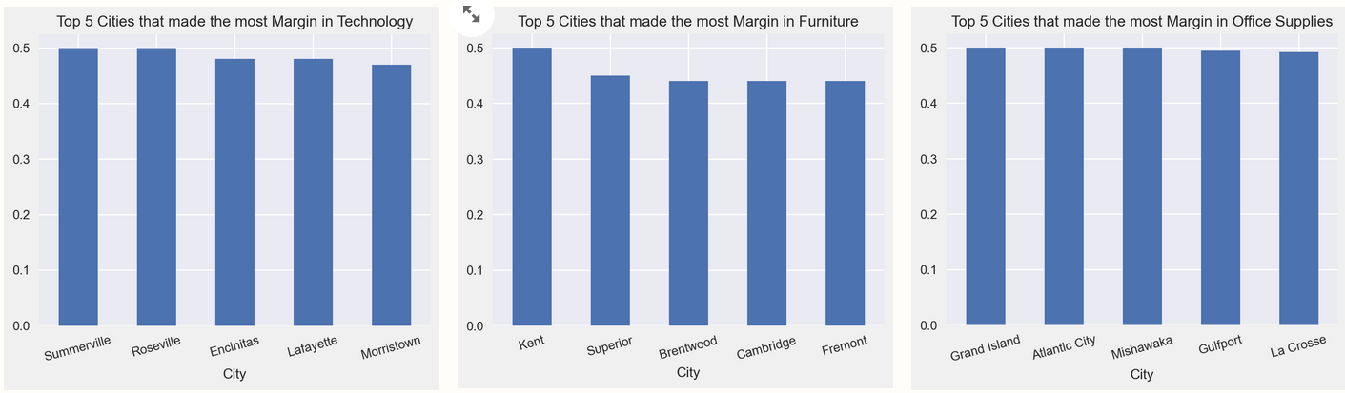

Slide 22
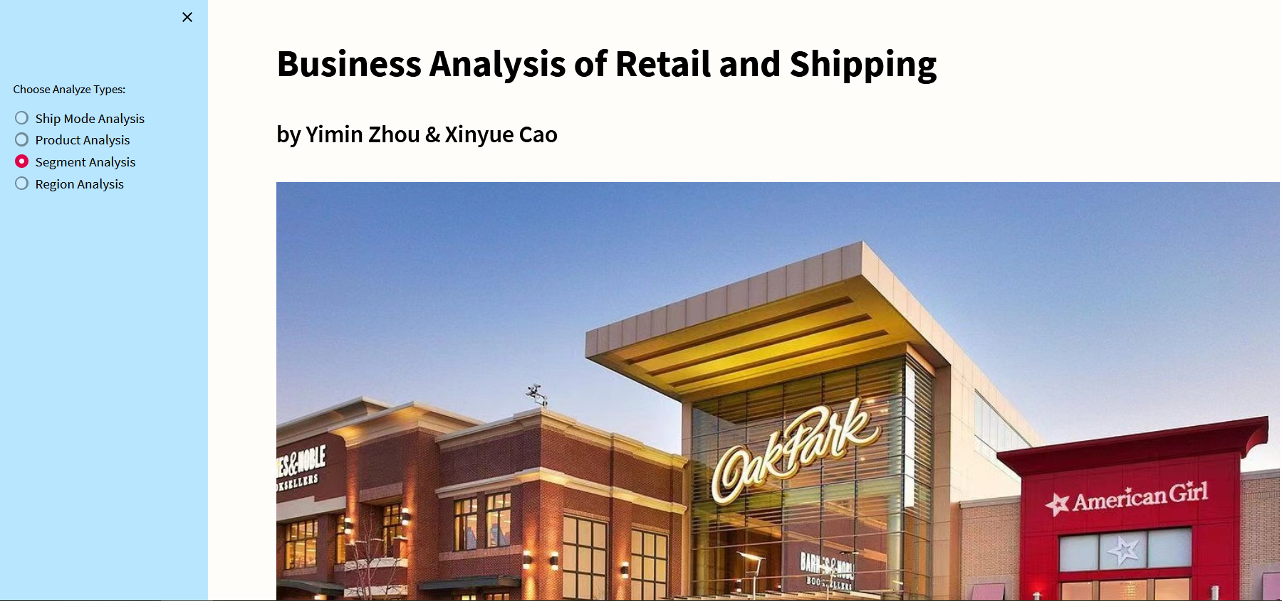
DEMO

Slide 23
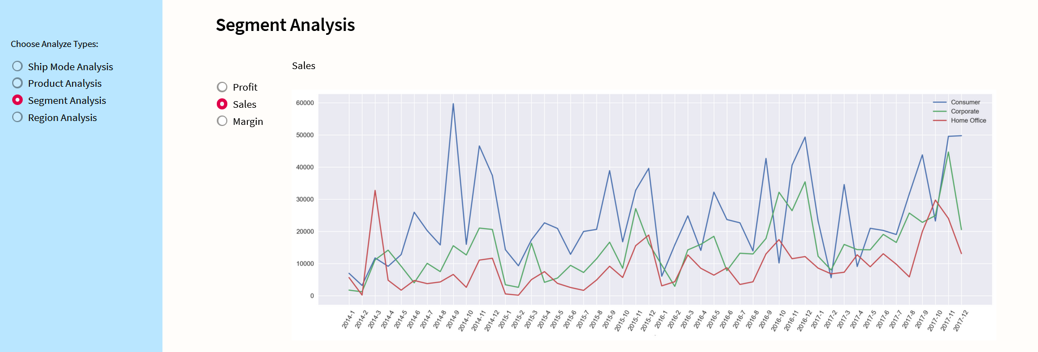
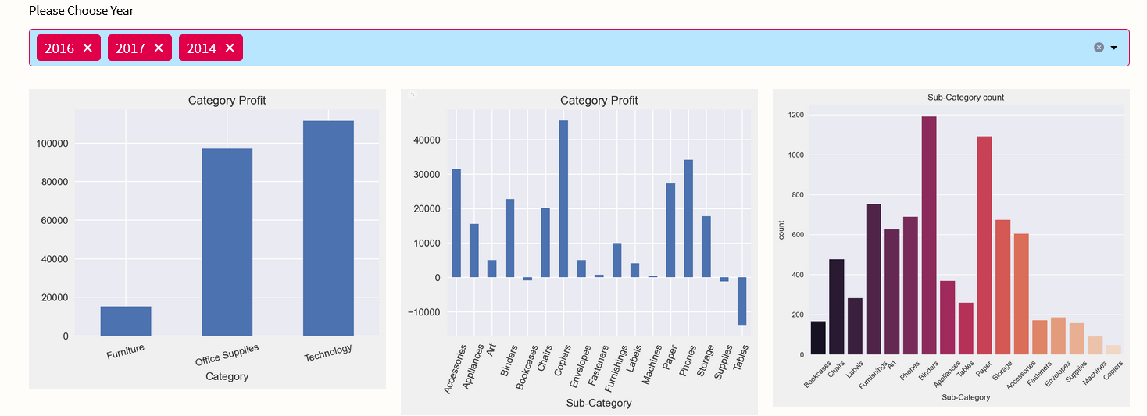

Slide 24
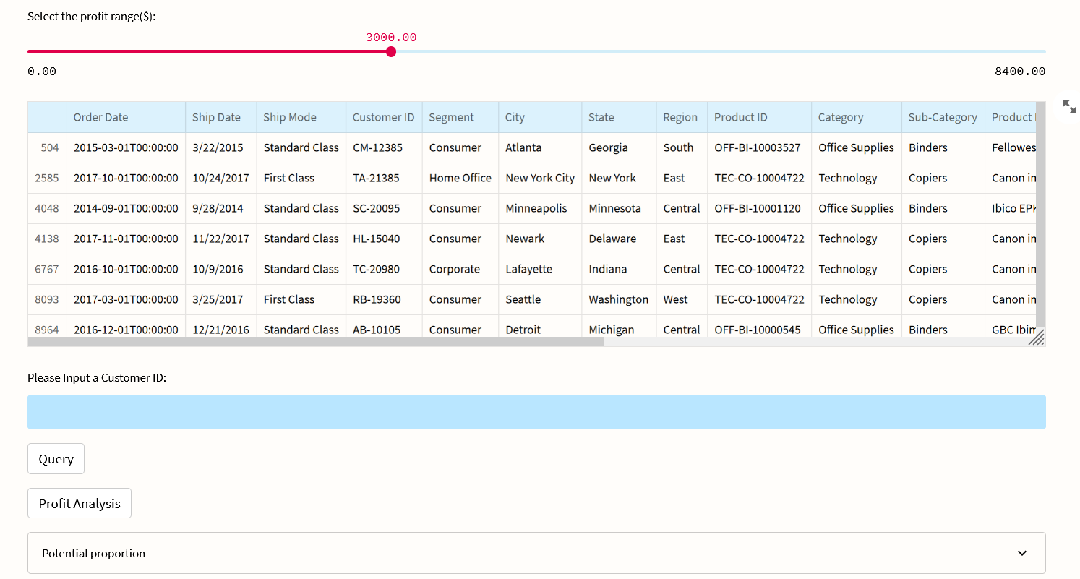

Slide 25
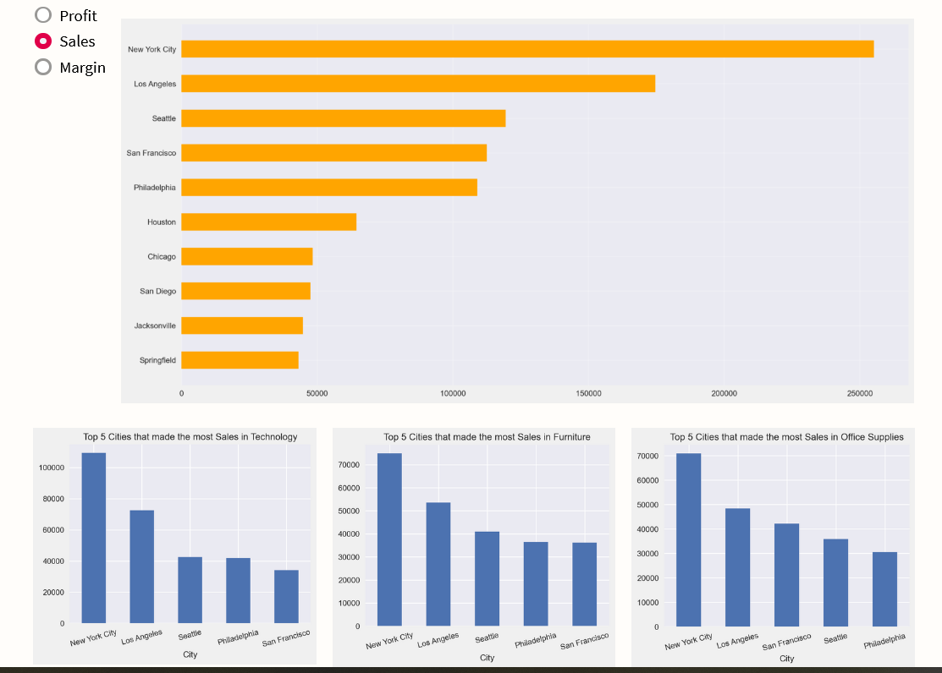

Slide 26
THANK YOU FOR WATCHING

